Slide 1
R Shiny noRth 2021 Fiona Lodge

Slide 2

R Shiny provides the ability to build interactive web applications with the power of knowing only how to code in R.
Today’s plan
Review of R Shiny basics
Simple app and add layers to explore concepts that will be needed for applications.
Customize the ui
Add the ability to upload data
Evaluation/Reactivity (some observations)
UI/Server Functions
Notes:
Todays plan is to review the basics of R Shiny application, and things that you need to know to program in R Shiny. Then, we will take a look at the syntax and functionality of a simple app. We will build some layers onto the simple app to explore more concepts and functionality. This includes (a) Customizing the UI, (b) uploading data to the app (3) We’ll take a time out to think about how Shiny evaluates and reacts to code, and lastly we’ll talk about functions and how they can improve the workflow. This talk will largely follow syntax and examples used in the book, Mastering Shiny by Hadley Wickham.

Slide 3
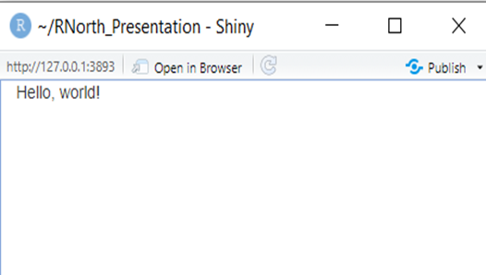
The structure of an app often consists of three files (ui, server, global) or the three components are saved in one file (app).
ui.r
server.r
global.r
app.r
There are many different reasons to build an app, and mostly dictated by what the business needs. However, it may be worthwhile to note that putting together a simple app for EDA or other analysis can be useful. Your shiny app does not need to always be used in production.
Notes:
An R Shiny app is a web application that is split into three functions in R. The ui is the user interface – where fluidPage sets up a very basic, single page layout. The server is a function that takes input from the ui, and the output are then filled by server. A global file may contains static variables/functions that are needed as a base to run the application. ShinyApp runs the application with the defined ui and server functions with shinyApp or Run app in the Rstudio console. When first beginning to learn R Shiny, it may be best to start by putting the ui, server and global needs in one file so that you can see how everything is interacting together. The R Shiny application is run with a URL – and this example just displays ‘Hello World’ in the ui.

Slide 4
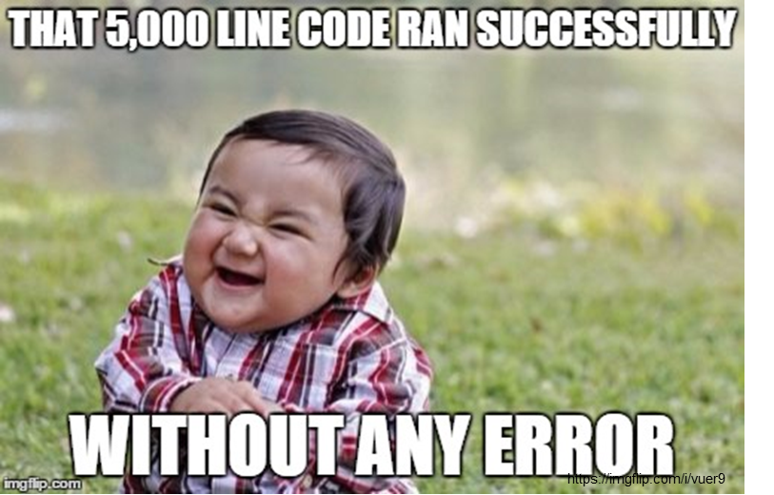
Tips when learning and progressing with R and R Shiny.
Beginnings
Don’t start with the data (counterintuitive).
Determine the easiest place to start.
Onwards
Scope
Coding structure (proof of concept vs. production)
Project management skills
(Some) Resources
Mastering Shiny, Hadley Wickham
RStudio https://shiny.rstudio.com/tutorial/
Shiny Developer Conference 2016 https://www.rstudio.com/resources/shiny-dev-con-2016/
Shinydashboard
https://rstudio.github.io/shinydashboard/index.html
Notes:
The first thing to remember when learning R or R Shiny is that you do not have to start with the data. You do not have to use complicated data or try to find obscure datasets. When I was first learning R, this was counterintuitive, because data comes first in your code, and is at the center of what you want to learn. However, it is much easier to learn concepts and techniques and experience success with them. Then, working with and understanding what the data needs will follow, but it is important to build your toolbox. Many R Shiny examples will use built-in datasets, and I recommend starting there.
Determine the easiest place to start. Often, coders might start with the ui – since it helps builds the scope and dictates variables in the server. Otherwise – you might start with functions that you definitely know you will need.
Once you have become comfortable with R Shiny, you will have to think more about how to manage your applications.
Some helpful tips :
- Think about the scope as much as you can prior to starting the application. Get a handle on what is needed from the application. The type of project (proof of concept) versus (production) will also help you think about what’s needed from the code.
- Shiny Apps contain a lot of moving parts and some feature development can be quite time consuming. It will be important to spend some time on project management. The nicer your application looks – the more that might be needed ☺

Slide 5
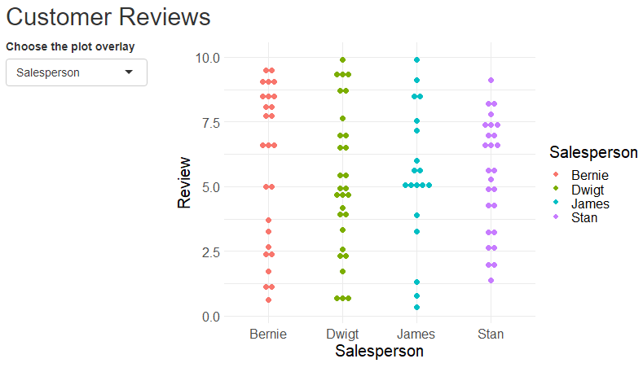
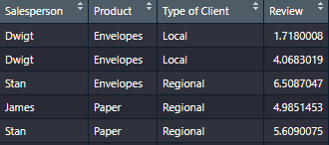
The app example looks at reviews about salespeople at a company across products and type of clients. We’ll build some more features into the simple app.
Simple App
Sample of Data (long)
Go to app!
Notes:
Explain the data and the plot. Go to R and explain the code for the simple app.

Slide 6
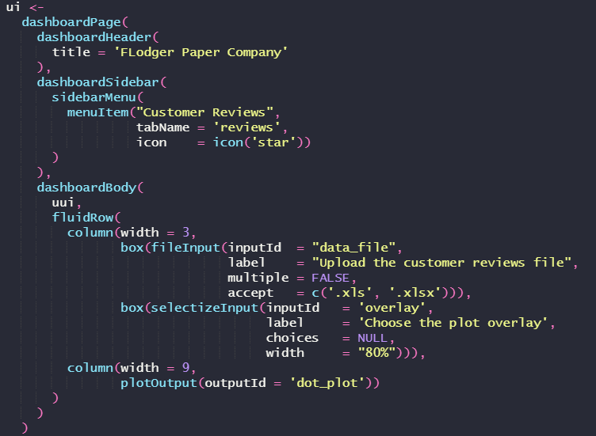
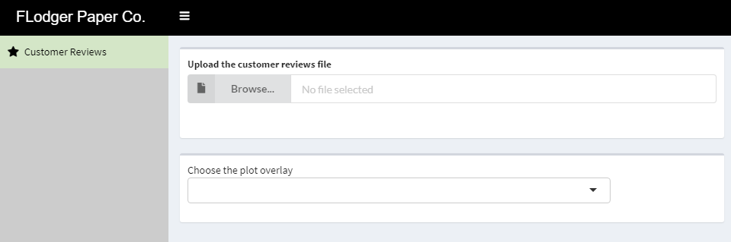
To customize the appearance, we’ll use the shinydashboard package in conjunction with a css file. The shinydashboard page sets up a standard dashboard layout for your shiny application. The three parts are a header, sidebar and body.
Go to app!
Notes:
Shinydashboard produces a standard dashboard layout that is already set up. This is set up in a header, sidebar, and body. It has its own syntax for certain items and how they need to be placed, but the heart of the body contains the same shiny syntax.

Slide 7
In reality, the dataset won’t be uploaded within the app. We’ll provide an example of fileInput to upload a dataset.
Implications to uploading a dataset to our application:
The choices for the plot overlay could change – we’ll want to make sure we capture those columns by updating the input options in the ui.
Some type of validation is required for the data upload
fileInput returns the following
name : filename on user’s computer
size : size in bytes
type : formal specification of file type (don’t worry about)
datapath : path to where the data has been uploaded on the server
Go to app!

Slide 8
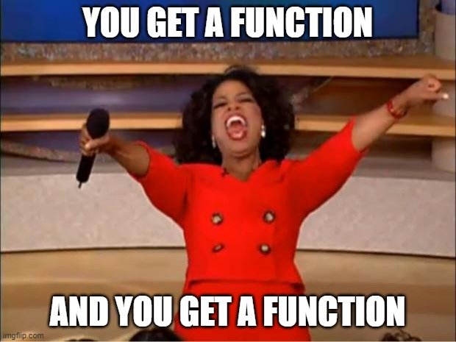
As apps get more complicated and longer, you’ll want think about what can be written in functions.
Many advantages to this:
Functions can be used in other places – and the app and code can be written in a package.
Code within server/ui will be shorter
Isolation in the testing/debugging process.
Functions can combine both ui and server (modules).

Slide 9
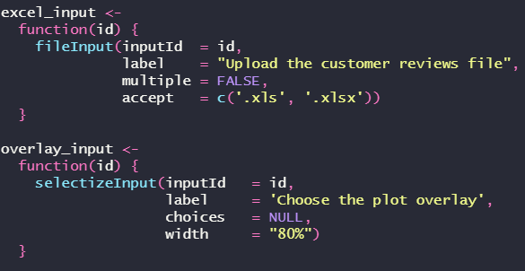
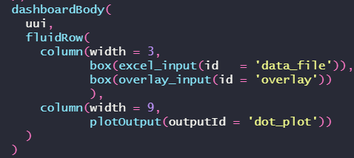
UI elements can be written as functions.
Functions in an R/ folder
UI

Slide 10
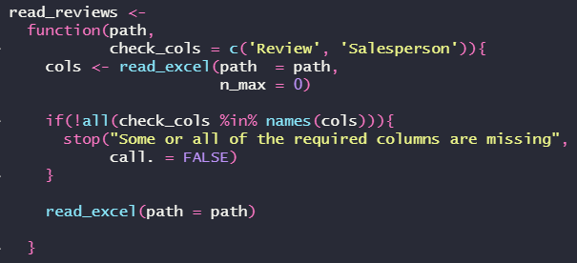
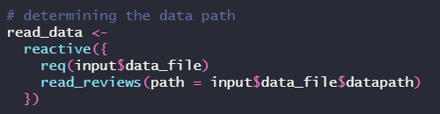
Server functions do not need to be written with reactive inputs, and it’s preferably not to. Here, a function takes in the data and checks for the Review and Salesperson column. The path is reactive within the context of the server.
Function in R/ folder
SERVER

